Slide 1
Active Learning
Cost-Effective Active Learning for Deep Image Classification

Slide 2
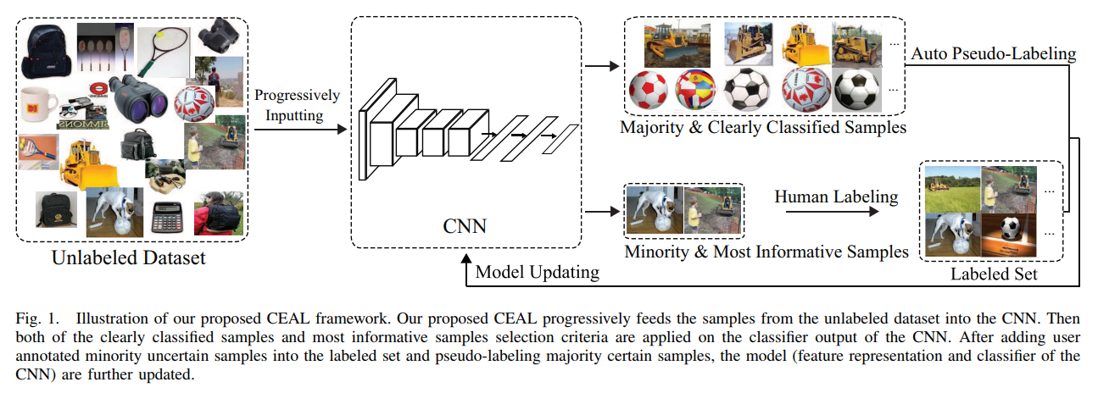
Cost-Effective Active Learning for Deep Image Classification

Slide 3
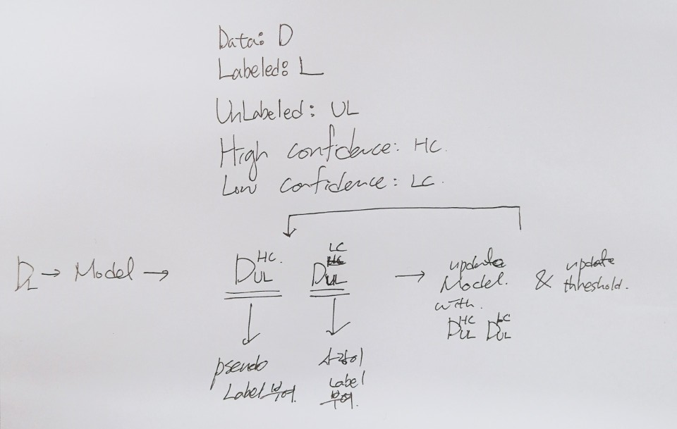
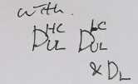
Cost-Effective Active Learning for Deep Image Classification

Slide 4
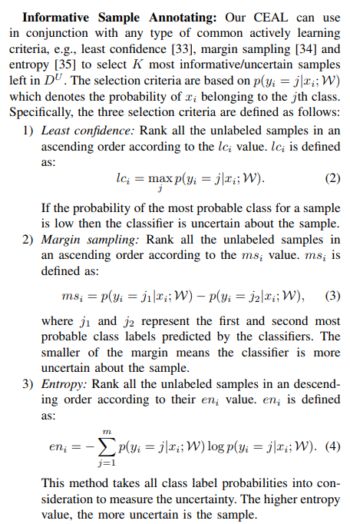
Label 부여할 데이터를 선택하는 방법
Note that compared with classification probability, the entropy considers the classification probability of other categories.
Cost-Effective Active Learning for Deep Image Classification

